Slide 1
FilterFPS
By Iskren vanev f104231

Slide 2
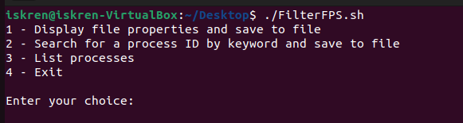
Introduction
FilterFPS Shell script provides a simple menu-driven interface to perform various tasks related to file operations and process management. Users can choose to display file properties, search for processes by keyword, list processes based on different criteria, or exit the script.

Slide 3
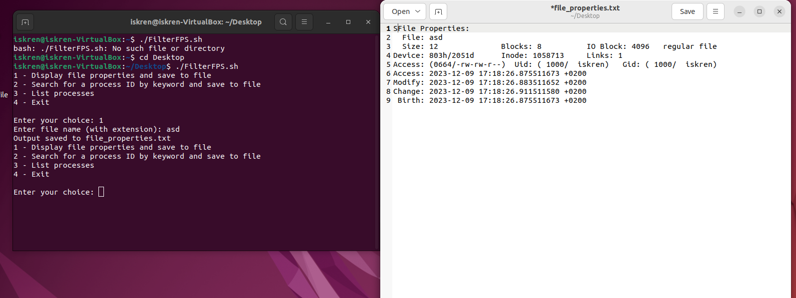
File properties
Prompts the user for a file name and displays its properties, saving the output to file_properties.txt.

Slide 4
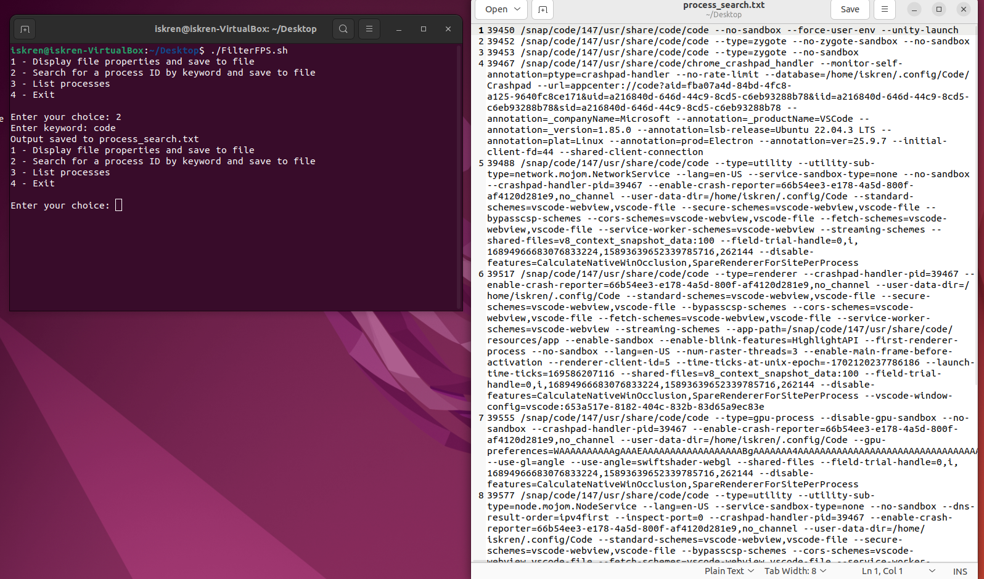
Process keyword
Prompts the user for a keyword, searches for processes containing the keyword, and saves the output to process_search.txt.

Slide 5
Process List
Provides sub-options to list processes by:
a) Process ID
b) Process name
c) Parent process name
d) Execution time

Slide 6
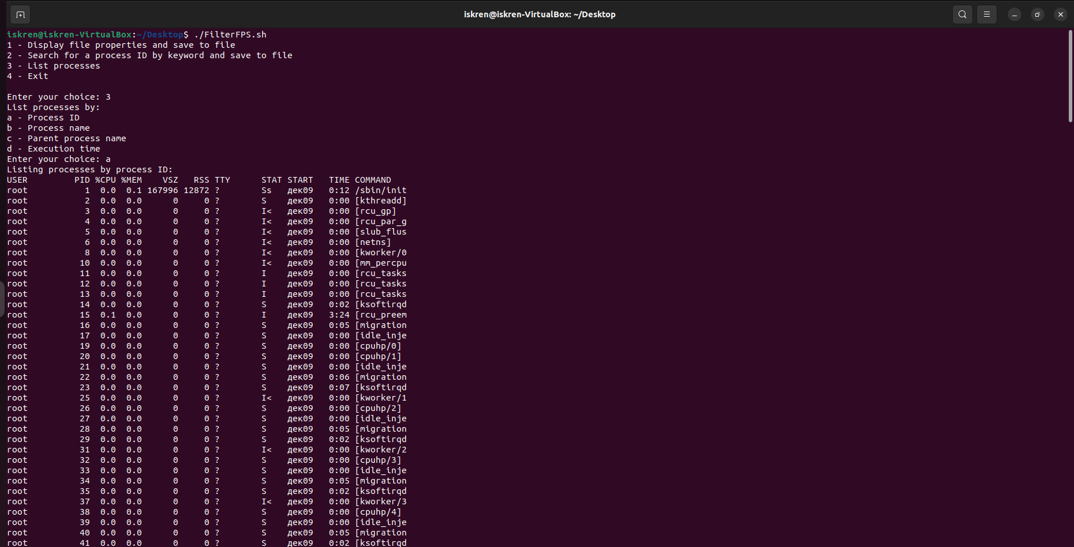
Filtering by process ID

Slide 7
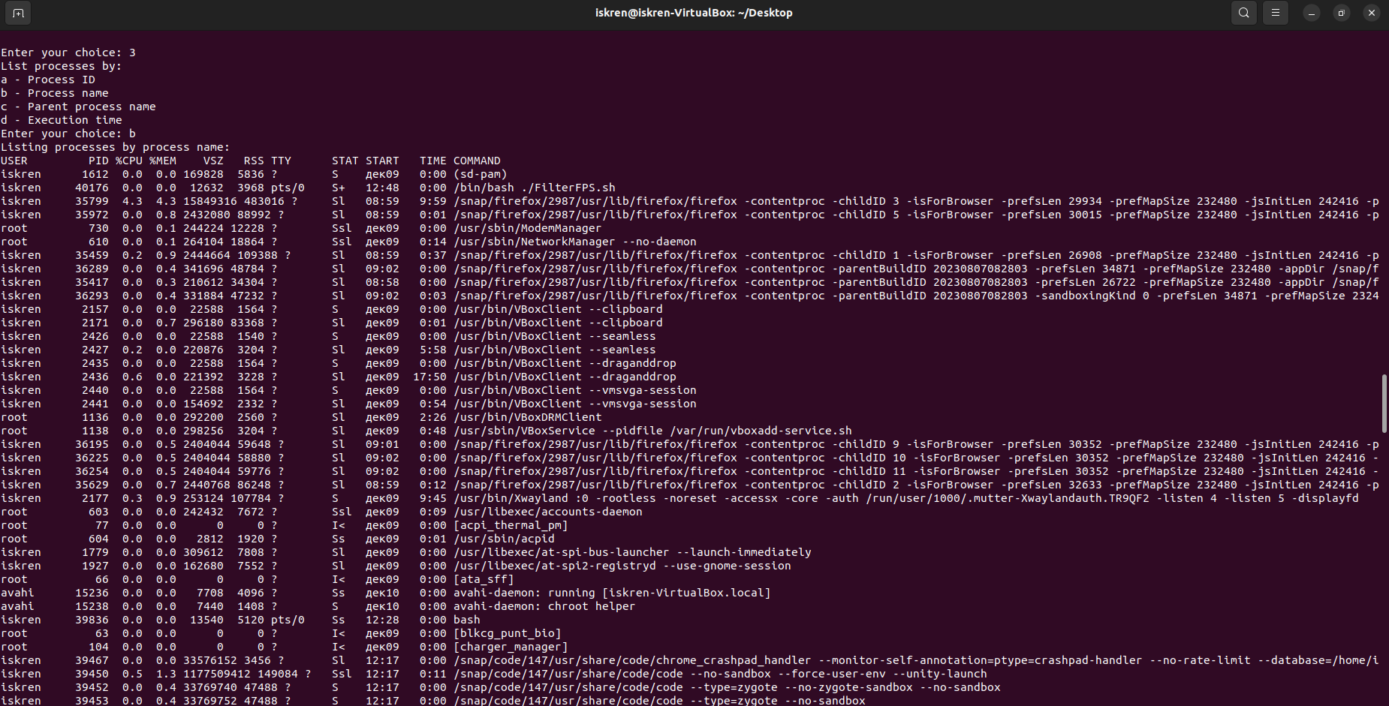
Filtering by process name

Slide 8
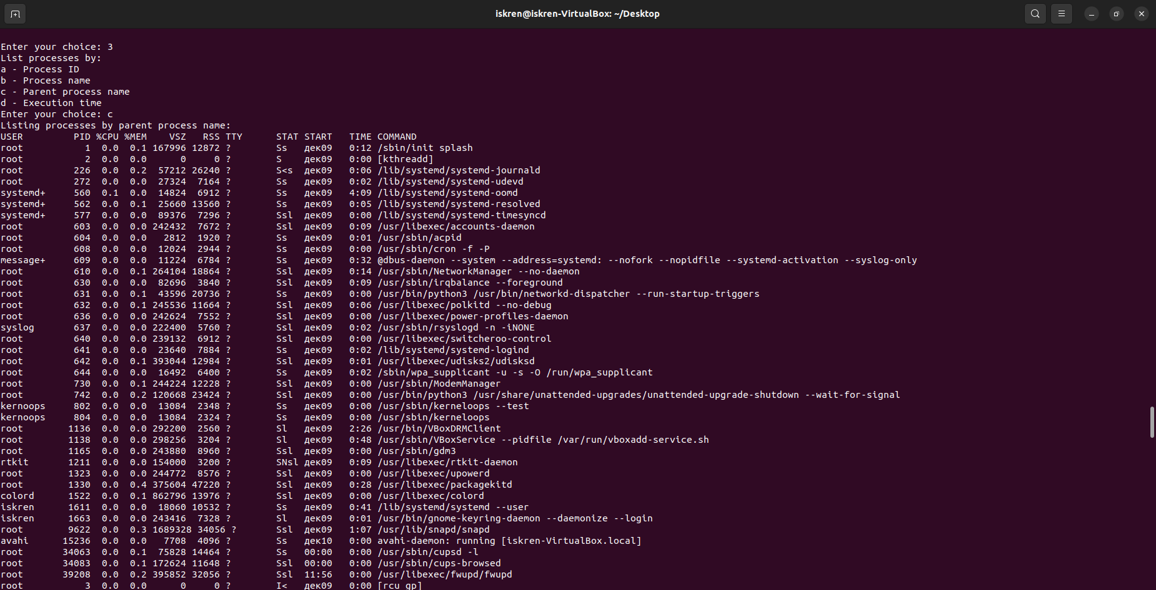
Filtering by parent process name

Slide 9
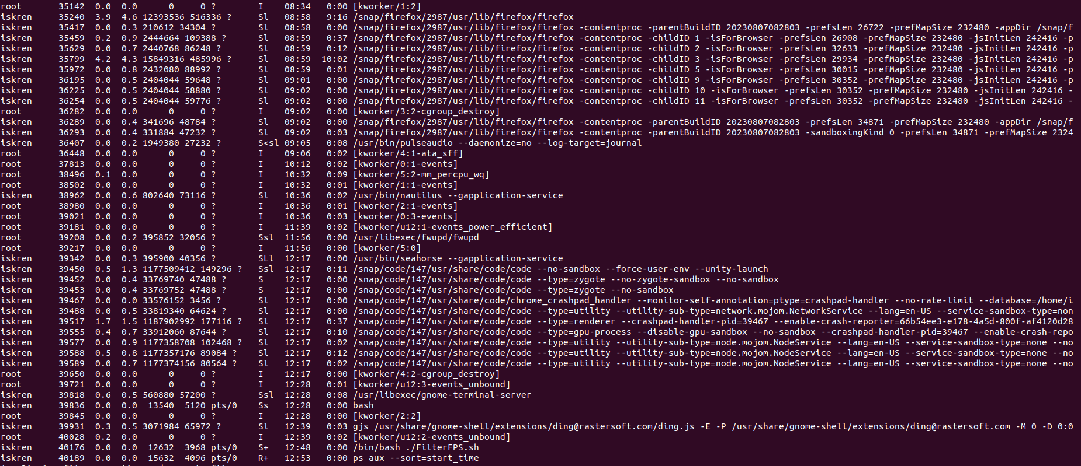
Filtering by execution time

Slide 10
Thanks for the attention! ☺

